Slide 1
Discrete Mathematics
Spring 2020
Yuan Ze University

Slide 2
Modular arithmetic

Slide 3
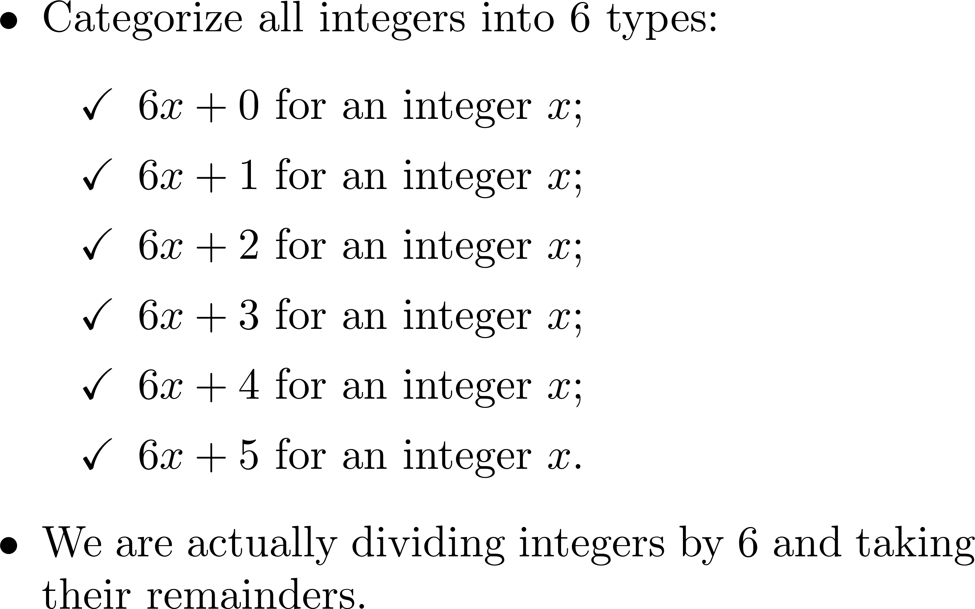
Observation

Slide 4
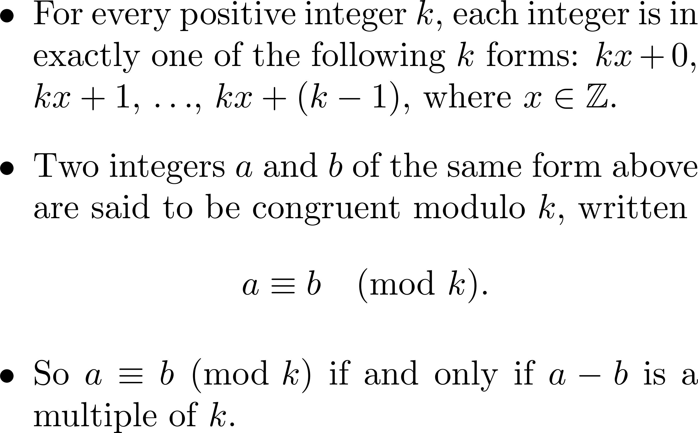
Congruence

Slide 5
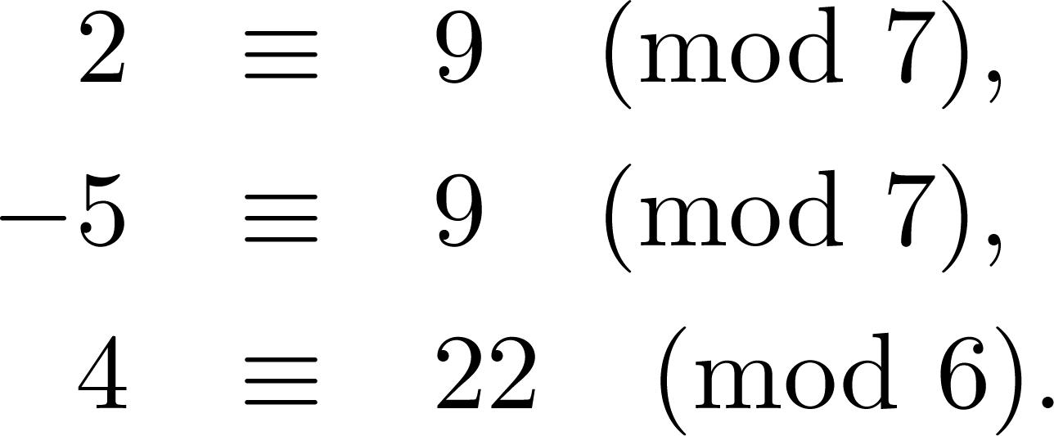
Examples

Slide 6
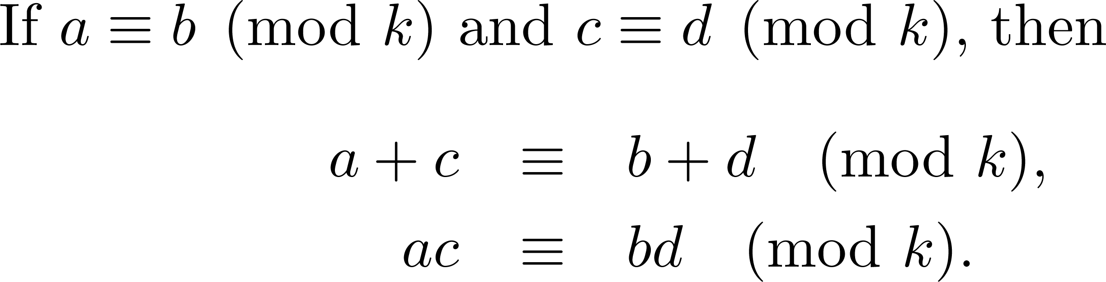
Modular arithmetic

Slide 7
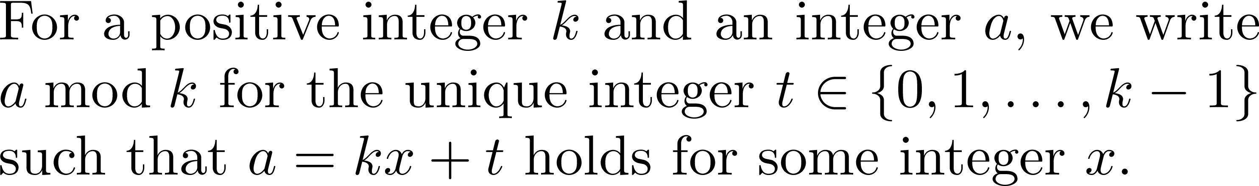
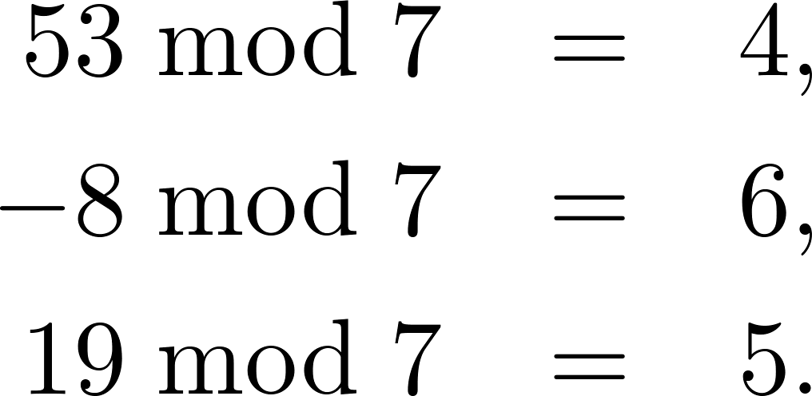
A notation

Slide 8
A fact

Slide 9
A fact

Slide 10

Questions?

Slide 11
Euclid’s algorithm

Slide 12
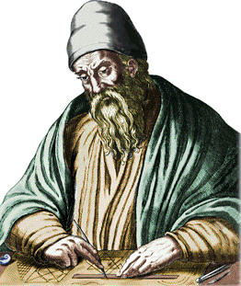
Euclid (about 300BC)

Slide 13
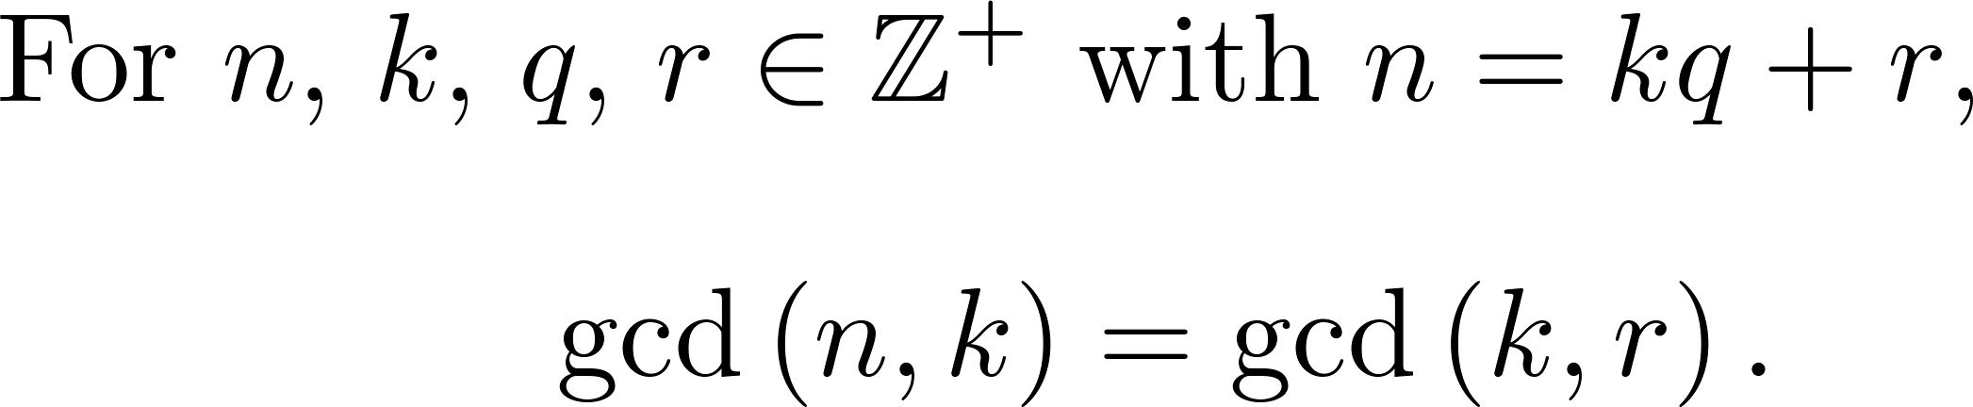
The key observation

Slide 14
But why?

Slide 15
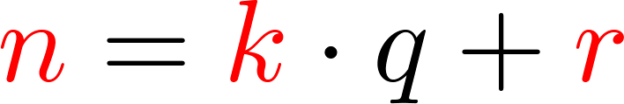

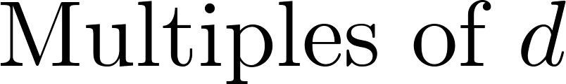
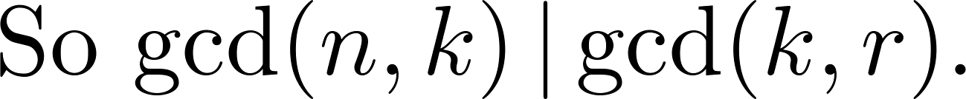
The magic

Slide 16

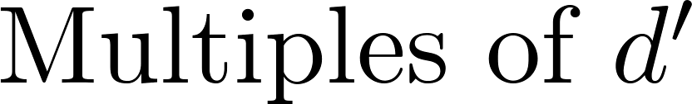
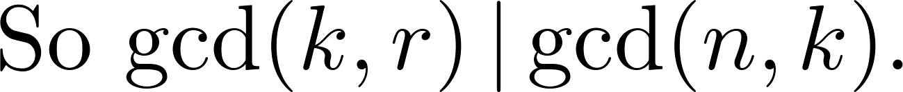
The magic

Slide 17

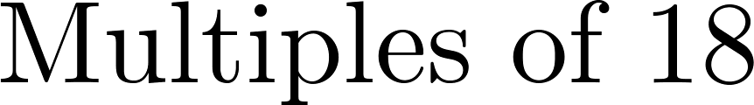
The magic: An example

Slide 18
The magic: An example

Slide 19
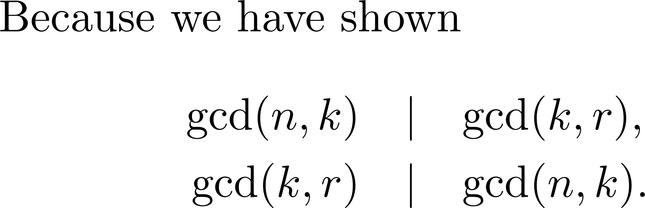
Proved!

Slide 20
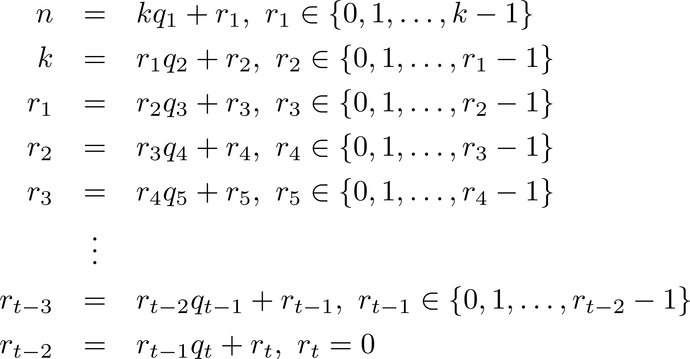
How Euclid’s algorithm works
Does this ever stop???
Yes!

Slide 21
After it stops…
We have just found the greatest common divisor of n and k.

Slide 22
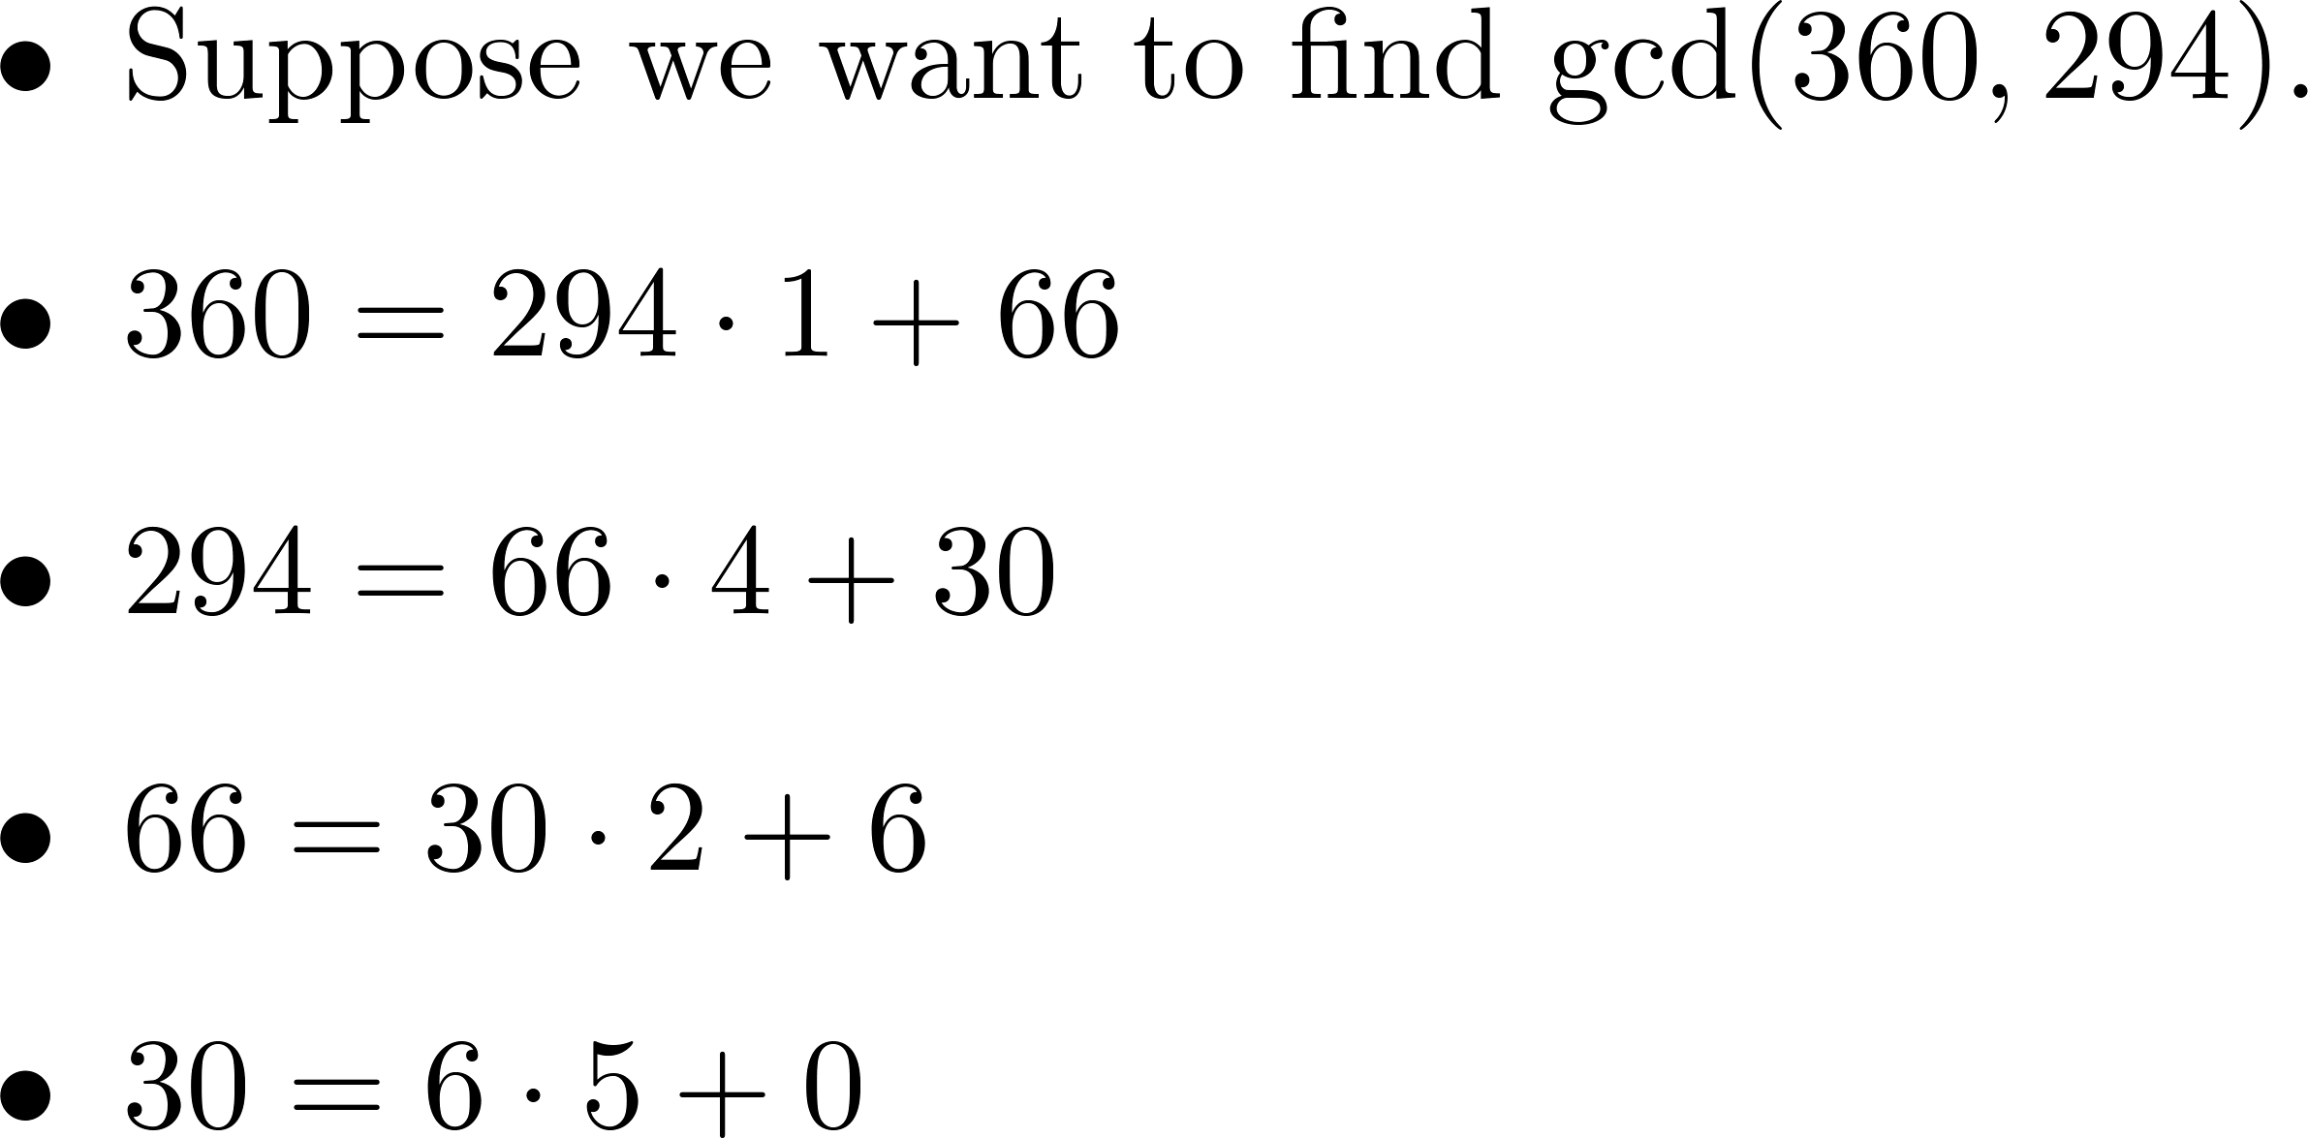
A concrete example
The remainders get smaller and smaller. So we eventually get a zero.

Slide 23
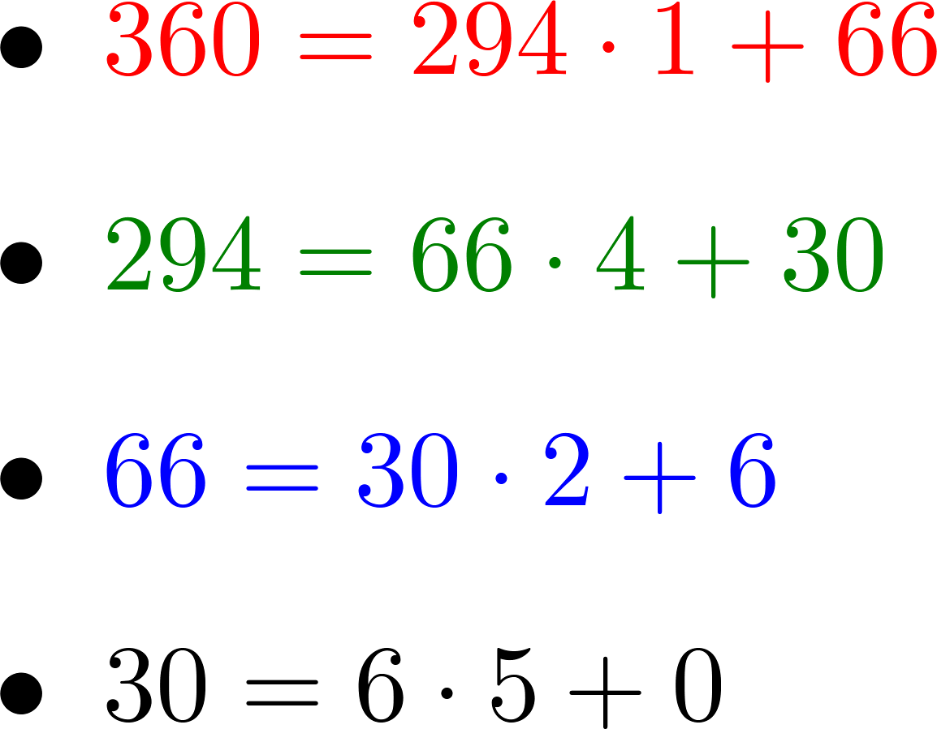

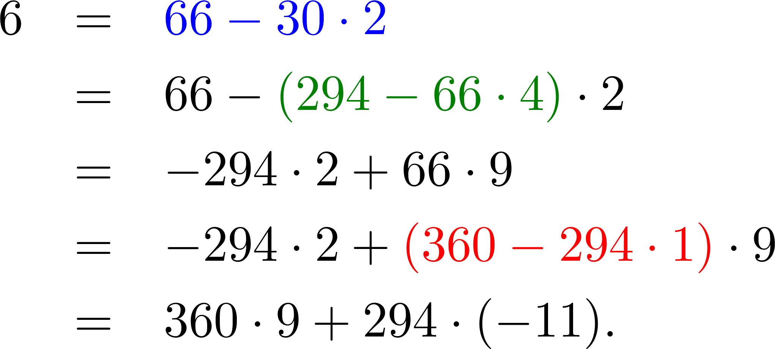
Getting it reversed…

Slide 24
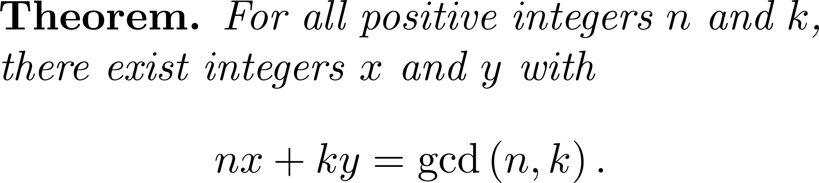

Slide 25
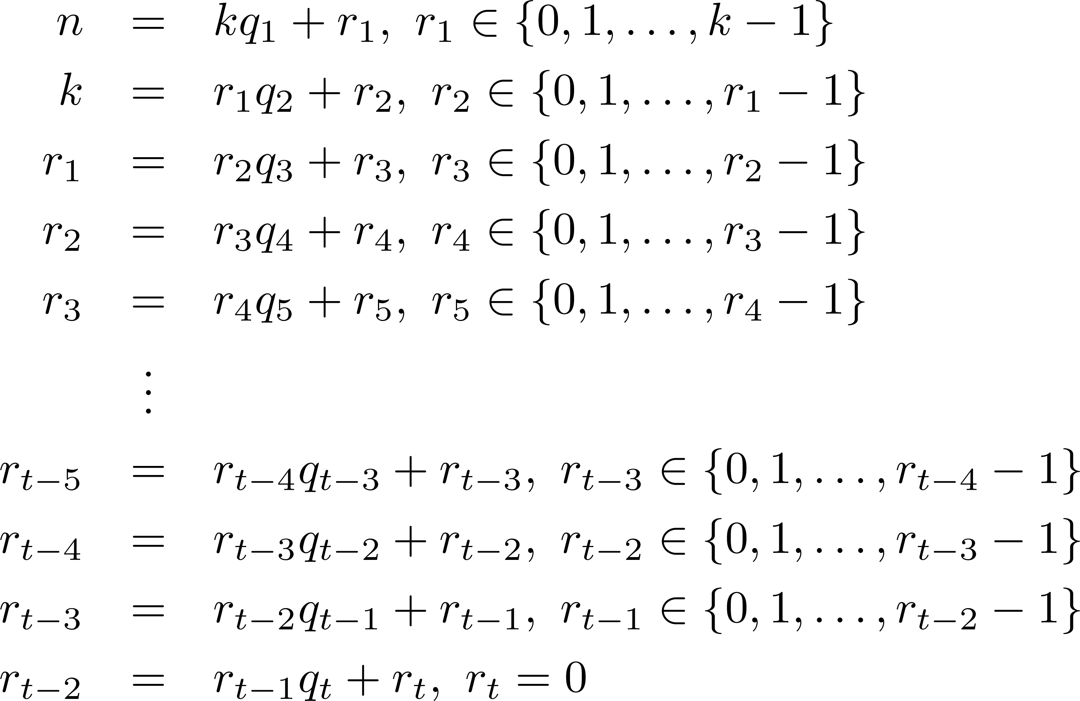
Going “upstairs”

Slide 26

Proved!

Slide 27
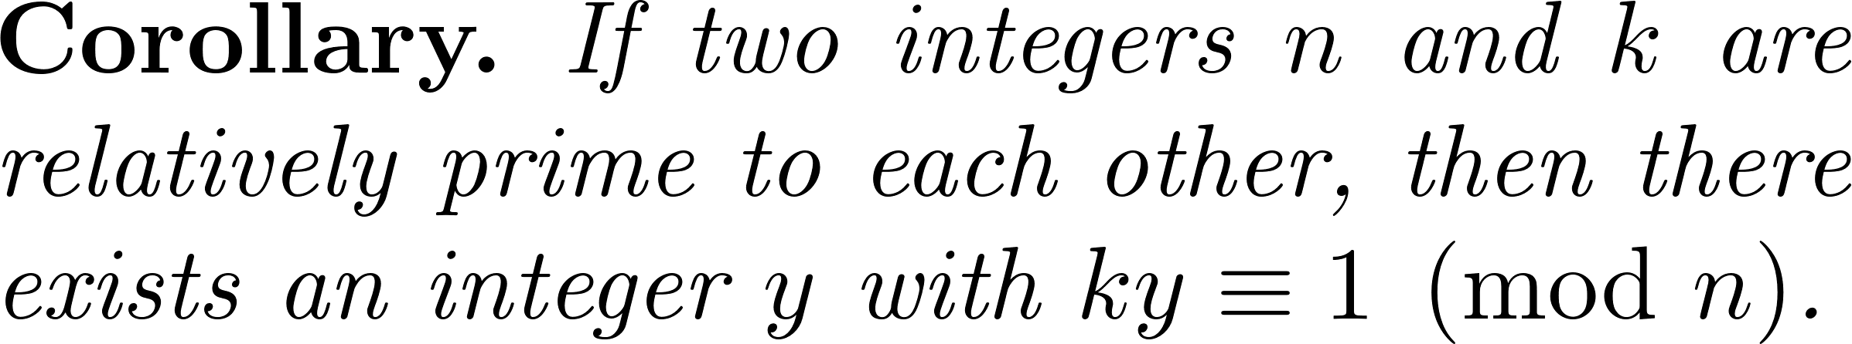
A corollary

Slide 28
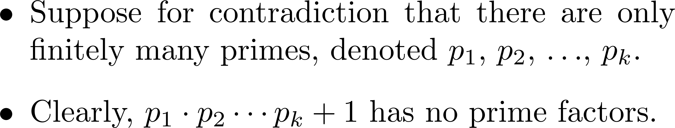
There are infinitely many primes
A contradiction occurs! (Why?)

Slide 29
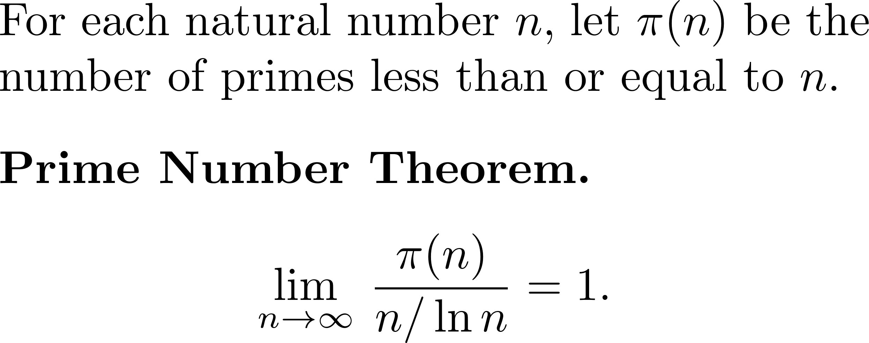
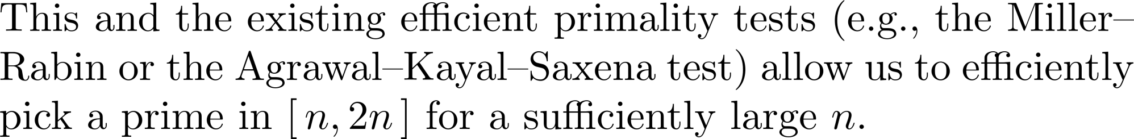
A stronger result

